Slide 1
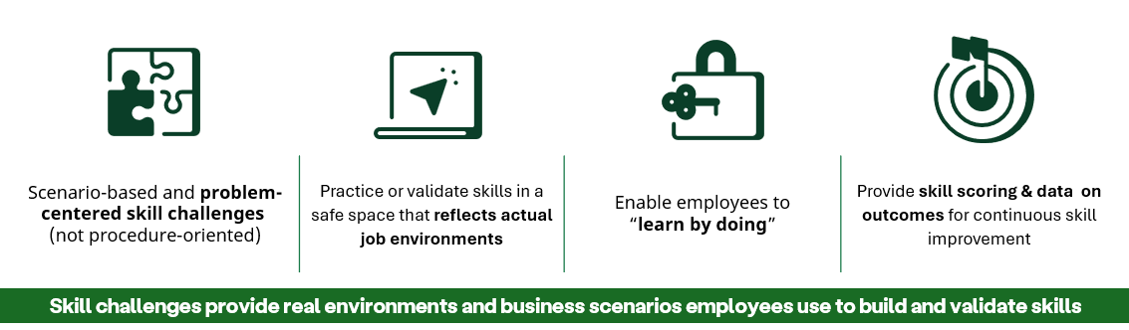
Skillable Challenges Design Tenants
Methodology:
Skillable Challenges are different from traditional step-by-step labs and ask learners to prove their skills by doing instead of following prescriptive step-by-step instructions.
Skillable Challenges are problem-centered and focused on end results. Empowering learners to explore, practice and “learn while doing” versus following a set of linear tasks.
They are goal-oriented, short-duration, hands-on scored labs that bring skills validation to the forefront of the learner experience.
Each Challenge should contain:
overview that sets the scene for the Challenge and outlines the tasks the learner will perform
a series of tasks that contain the configuration requirements the learner will perform.
a means of verification, allowing the learner to gauge success.
Summarizes and highlights what the learner accomplished and provides information about related content that learners can use to build skills

Slide 2
Authoring/Formatting Skillable Challenges Cheat Sheet(s) – Learner Experience by Level
 | Guided | Advanced | Expert
Duration | 15-30 minutes | 30-45 minutes | 45-60 minutes
Audience Level | Familiar with concept but lacking experience and knowledge. Needs to be led through | Good understanding of some but not all the topics. Able to work with more complex scenarios | Solid understanding of all topics, interested in testing themselves to find gaps in knowledge and skill.
Tone | One on one mentor talking to learner. “You need to complete these steps….”. Instructions are worded as procedures. | One on one, mentor to learner, posed as needs or wants/requirements, worded as goals. “You need to configure x to do y”. | Formalized – use exam style language. “You are required to” and “Requirements”
Challenge Title | Posed as statement | Posed as question | Posed as a question
Scenario | Keep as simple as possible. | Somewhat Complex - Need to know information but may be include additional context to provide richer context. | Complex - Need to know information but may be include additional content to provide richer context. May include diagrams, resource table, etc.
Pages of Work (Requirements) | 2-4 Pages | 3-8 Pages | 3-8 Pages
Tasks | Supportive, but encourages discovery as opposed to exact prescriptive tasks | Support the requirements but multiple tasks are summarized | Support the requirements but multiple tasks are summarized
Hints | What to do, generalized. Think of this as a bread crumb trail | Where to find out what to do, but not specifically what to do | n/a
Validation | Series of scored binary statements scored as they are completed with final score calculated at the end. | Series of scored binary statements scored as they are completed with final score calculated at the end. | Set of requirements presented as you go, but all verified/scored at the very end of the challenge.

Slide 3
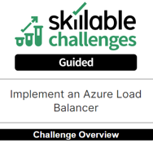
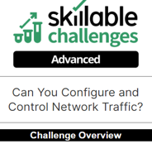
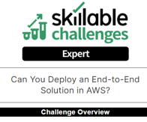
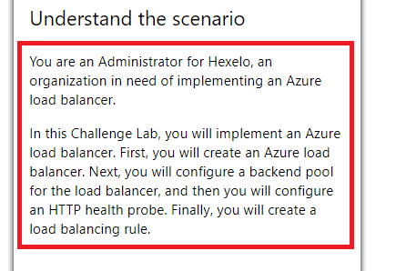
Authoring/Formatting Skillable Challenges Cheat Sheet(s) - Structure and Format
Title
A Guided challenge title must begin with an action verb.
An Advanced or Expert Challenge Lab title is phrased in the form of a question and begins with the words “Can You …?”
The title should reflect the key skills being tested in the Challenge
Overview
Elements:
The Scenario
The Job Title
The Company Name
Sample Scenario Verbiage:
You are a @lab.Variable(GlobalSecurityEngineer) for @lab.Variable(GlobalCompany), an organization that needs to rapidly deploy custom webservers securely.
In this Challenge Lab, you will configure a secure custom Amazon Machine Image (AMI). First, you will launch and patch a new Linux instance. Next, you will configure the instance with Apache webserver while hardening its security configuration, and then you will create a custom AMI from the instance. Finally, you will launch a new production webserver by using the custom AMI.
The problem solving for
Description of what will be accomplished in the Challenge

Slide 4
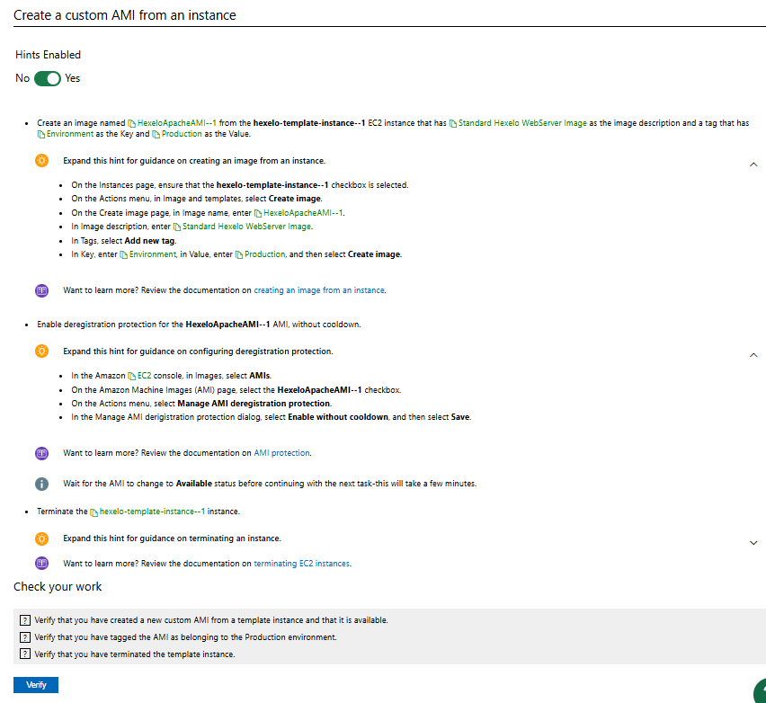
Authoring/Formatting Skillable Challenges Cheat Sheet(s) - Structure and Format
Requirement
Task
  Hint (Guided) – high level steps
  Hint (Advanced) – link to documentation
Task
  Hint (Guided) – high level steps
  Hint (Advanced) – link to documentation
Task
  Hint (Guided) – high level steps
  Hint (Advanced) – link to documentation
Check your Work
Skillable Challenges contain no less than 3 Requirements. Requirements are made up of Tasks. In Guided and Advanced Challenge Labs, the Tasks also contain Hints

Slide 5
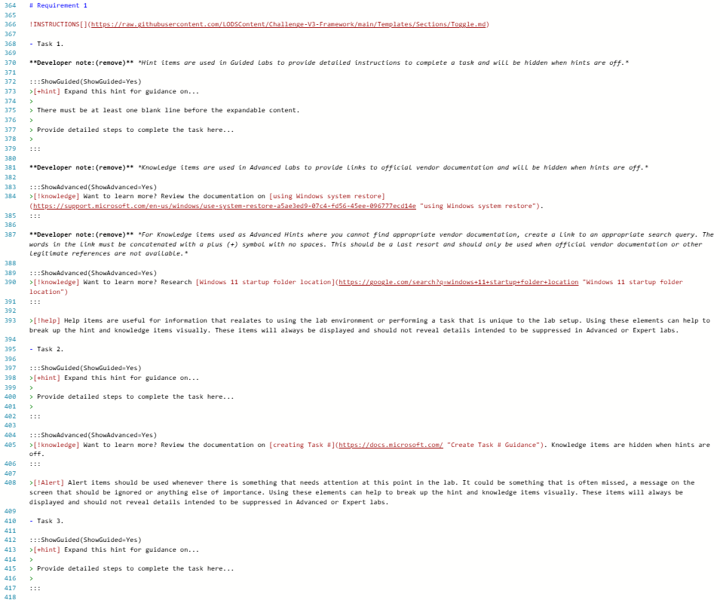
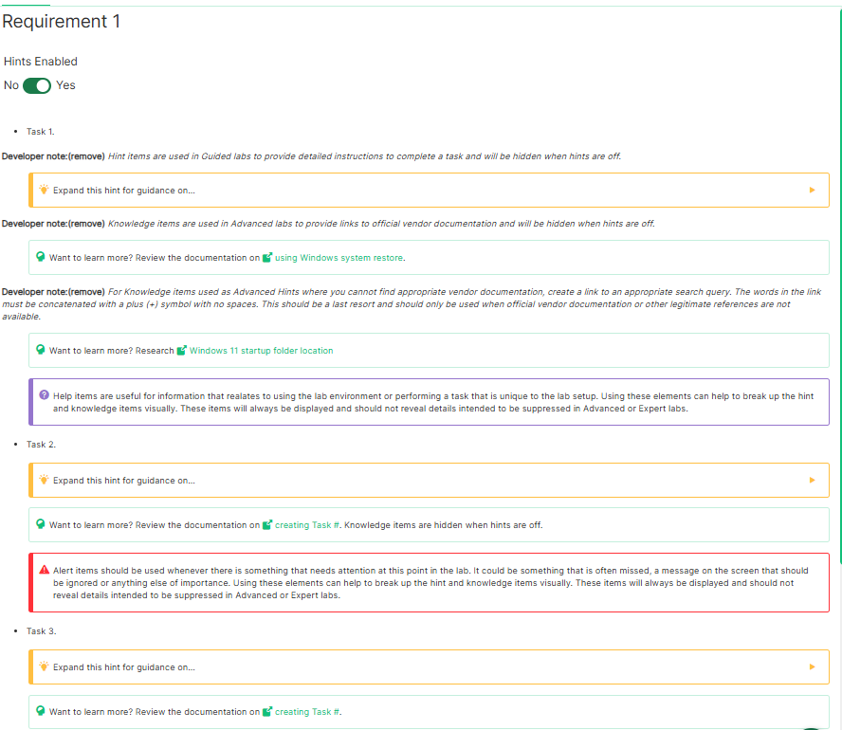
Authoring/Formatting Skillable Challenges Cheat Sheet(s) – Markdown/Template View

